Slide 1
Managing Chemical Costs Problem: Overall Chemical Costs Increasing
Symptoms:
A ~4MGD Drinking Water Plant feeding KMn04, PAC, Sulfuric Acid, Coagulant, Fluoride, Chlorine, KOH, Phosphate, Ammonium Sulfate saw chemical costs rising
The utility wanted to understand what was driving the costs and put some processes in place to manage chemical usage
Results:
~$25,000/year in chemical savings
Less than 1 hour required for detailed analysis and solution discovery
Making data-driven decisions – data shows trends, issues and improvements leading to:
Better budgeting
More efficient operations
Better communications

Slide 2
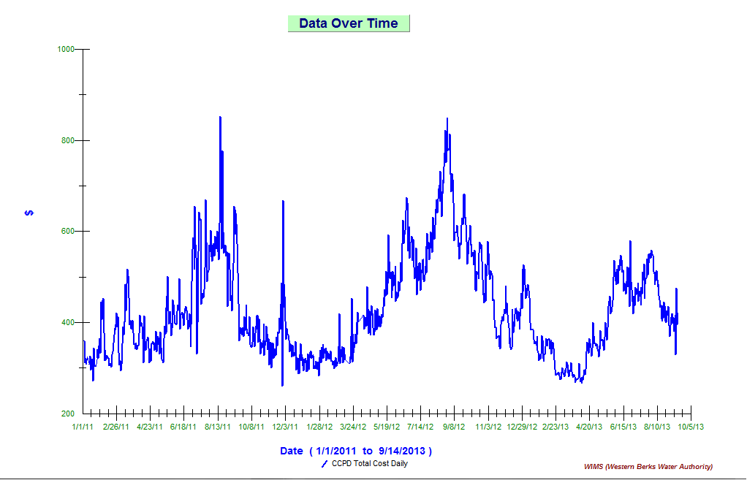
Analyzing the problem
The principles of “Plan-Do-Check-Act” provide sustainable results.
Use WIMS historical data to drill down to identify the problem
The team started with
an overall cost analysis
and then drilled down to
test for everything that
impacts Raw Water vs
Cost – Turbidity, DO, Mn,
FE, ph, Temp, OP, Algae.

Slide 3
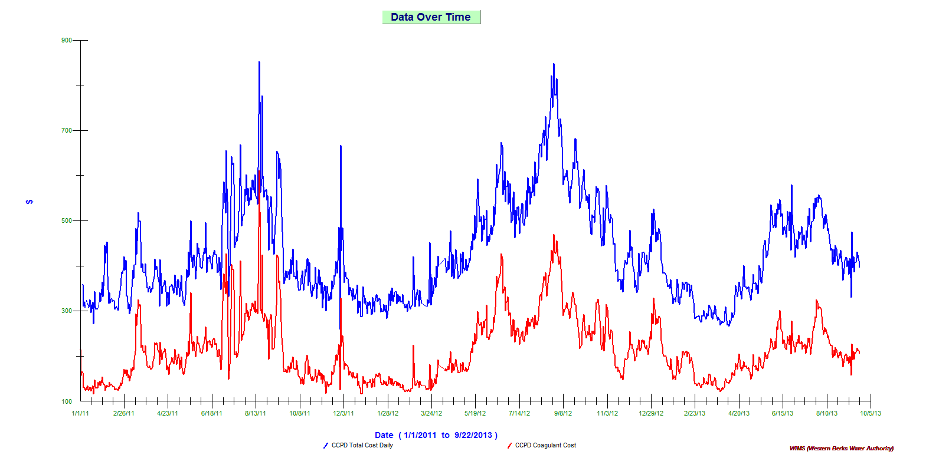
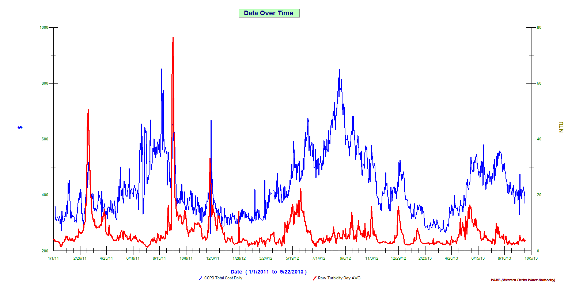
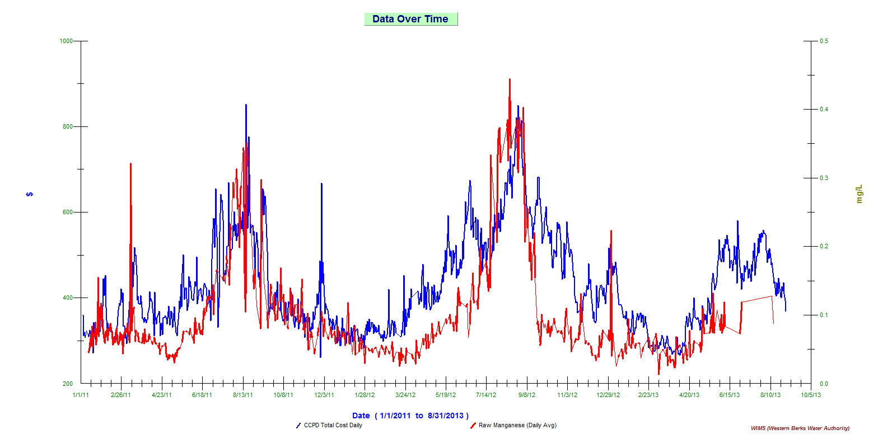
Identify the problem and take action
The trend graph show that Coagulant is causing the cost increase
The turbidity graph shows the costs spiked without an increase in turbidity – the question is why.
Further analysis showed that Mn caused the turbidity to creep up at post DAF (pre filter) prompting the addition of more coagulant. Instead, more KMN04 was needed to oxidize the Manganese – adding of Coagulant had no effect on the problem
Notes:
3

Slide 4
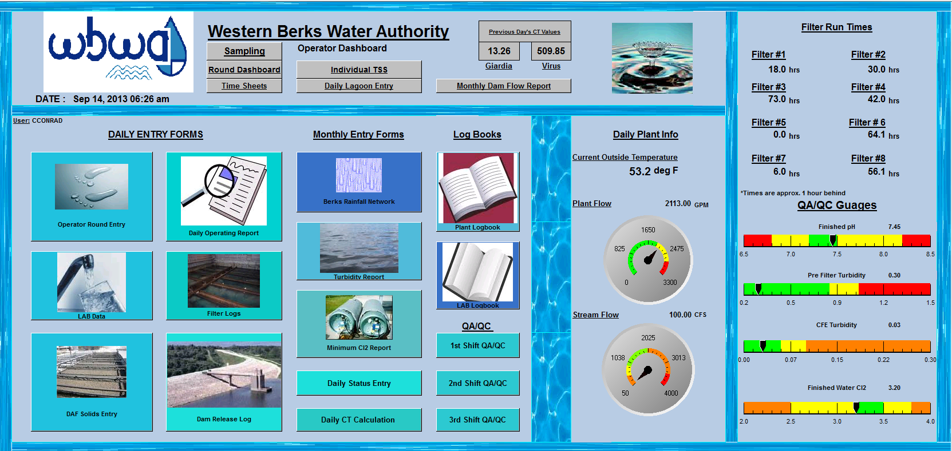
Sustainability
Dashboards monitor overall performance to help assure optimal operations
Daily trend graphs help keep costs under control
Once analysis was complete and the problem understood, chemical costs dropped – summer peak was cut in half
Notes:
4

